Slide 1
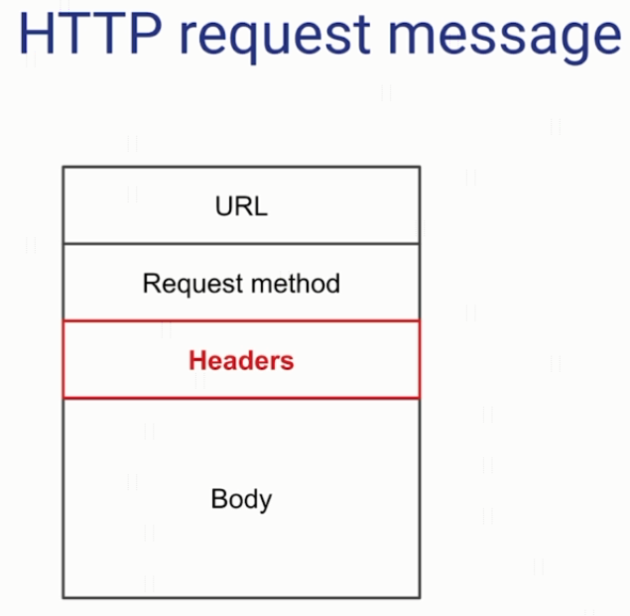
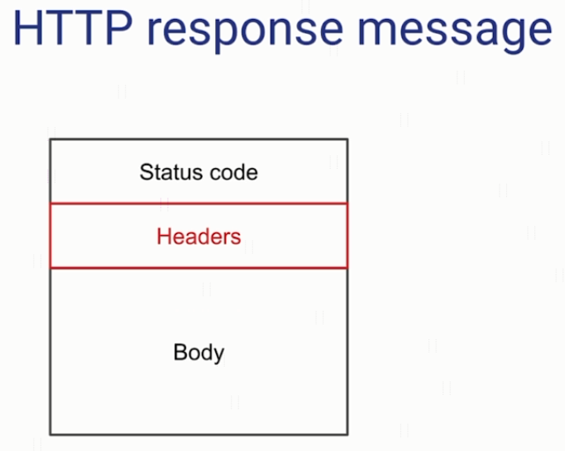
HTTP Headers

Slide 2
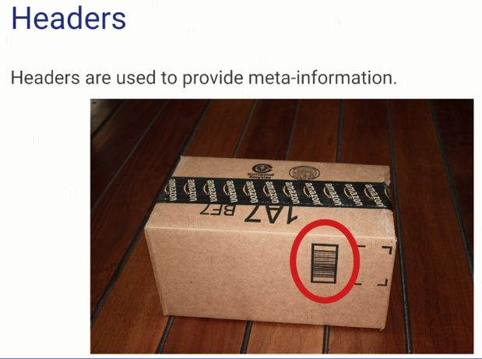
HTTP Headers

Slide 3
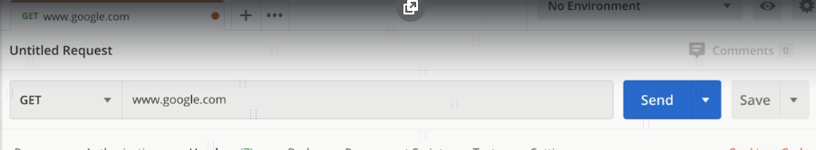
HTTP Headers
explain

Slide 4
HTTP Message Structure
https://www.udemy.com/course/introduction-to-apis-rest-api-graphql-soap-web-services-grpc/learn/lecture/19945648#overview

